Slide 1

AI App User Manual
By Ashtyn Jay

Slide 2
Table Of Contents
Acknowledgements Contact Person
About Me Thank You
About My Journey With Clevered
About App
How Do I Use The App
Quiz Generator
Demo Video
Toolkit Walkthrough

Slide 3

Acknowledgements
I would like to thank my parents for encouraging me, my mentors for pushing me onwards and helping me, and I would like to thank Dr Ken Kahn for believing me.

Slide 4
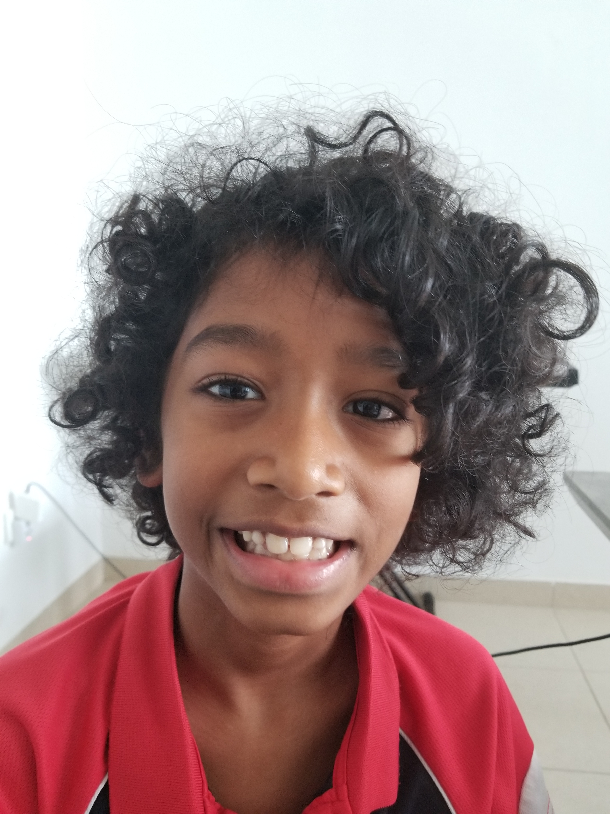
About Me
Hello, My name is Ashtyn Jay Manivannan. I am 11 years old, and I am in grade 6. I am from India, but I live in the UAE. My hobbies are reading and drawing, and I like AI because it's amazing that how big it has become. I hope to be able to study it more when I grow up.

Slide 5

About My Internship Journey With Clevered
My Internship Journey has been very nice. I learnt a lot of things along the way, and I feel much more knowledgeable than when we started. Overall, the journey was very good, I hope I will get another opportunity to do it again.

Slide 6

About My App
My app is a Quiz Generator. It has two levels: Easy and Hard. The main Purpose of the app is to get you to answer all the questions correctly. The useful part of this app is that it can be used to help you with your studies. Just create a JSON file with all the questions you need and you're all set. If you want, you can just follow the premade questions and improve your trivia knowledge. It's simple and doesn’t require much code.

Slide 7
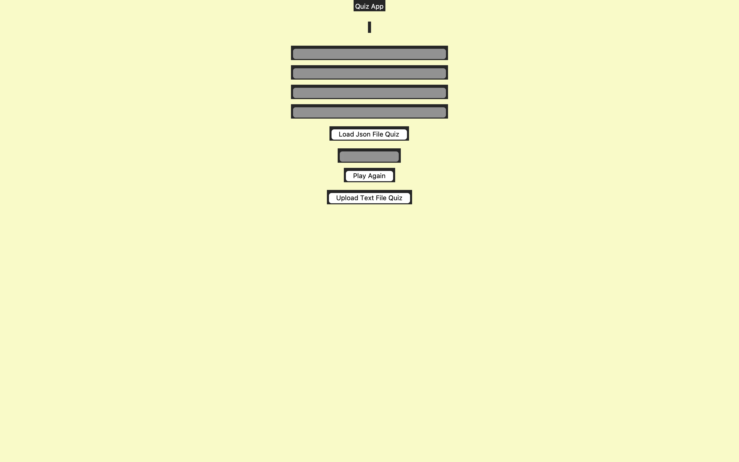
How Do I Use The App
Click To Load Questions
Click To Play Again
(Optional)Different way to Load Questions

